Slide 1

SUPPLY CHAIN MANAGEMENT

Slide 2
CLIENT INFORMATION
Client - WALMART
Walmart Inc is an American multinational retail corporation founded in 1962 that operates a chain of hypermarkets(also called supercenters), discount department stores, and grocery stores in the United States, headquartered in Bentonville, Arkansas.

Slide 3
Project business need
Deliver to customers without spending too much.
Stay ahead of the competition.
To minimize risk of stockouts.
Efficiency and Cost Reduction.
Inventory Optimization.
Risk Mitigation.
Customer Satisfaction.

Slide 4
Project Architecture
SCM
MANUFACTURER
ADMIN
RETAILER
ADD PRODUCTS
ADD RETAILERS
ADD MANUFACTURER
ADD DISTRIBUTOR
MANAGE UNIT
MANAGE CATEGORY
MANAGE AREA
CHANGE PASSWORD

Slide 5
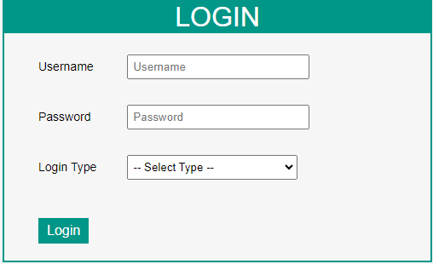
Project Module Login Page Admin, Manufacturer and retailer will have their dedicated credentials in order to access the application

Slide 6
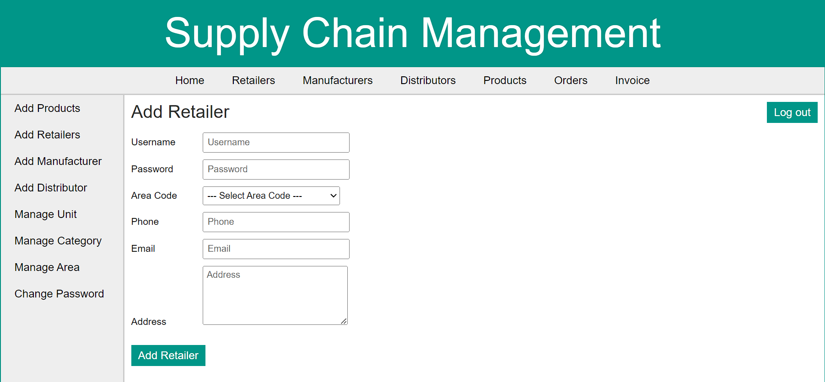
Module 1: Add Retailer 1.A retailer is a business or individual that sells goods or services directly to consumers for personal or household use 2.We can add entries into retailers page which can be later edited, deleted and updated successfully.

Slide 7
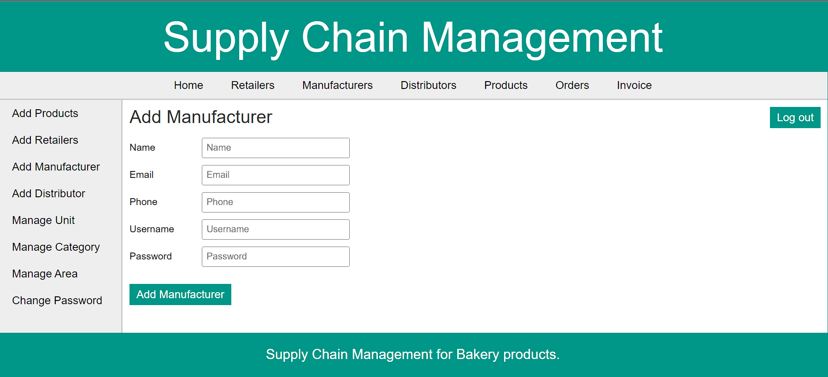
Module 2: Add Manufacturer 1.A manufacturer refers to a company or entity that transforms raw materials or components into finished products for sale to customers. 2.Once we add entries into manufacturer field, details of new manufacturer is created.

Slide 8
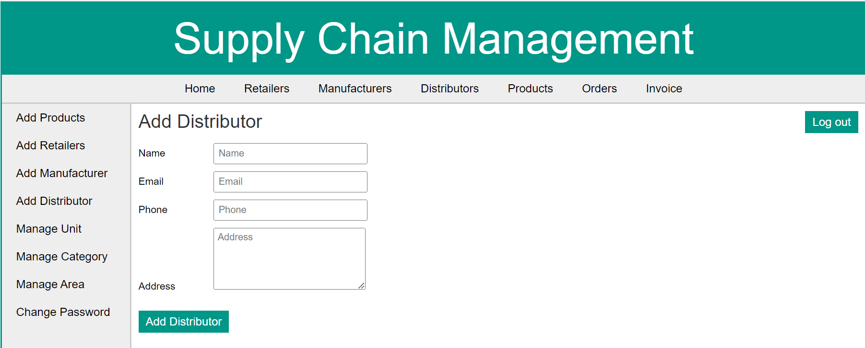
Module 4:Add distributor 1.A distributor is an entity or organization that acts as an intermediary between manufacturers and retailers or end customers. 2.New distributor can be created by adding entries into distributor field.

Slide 9
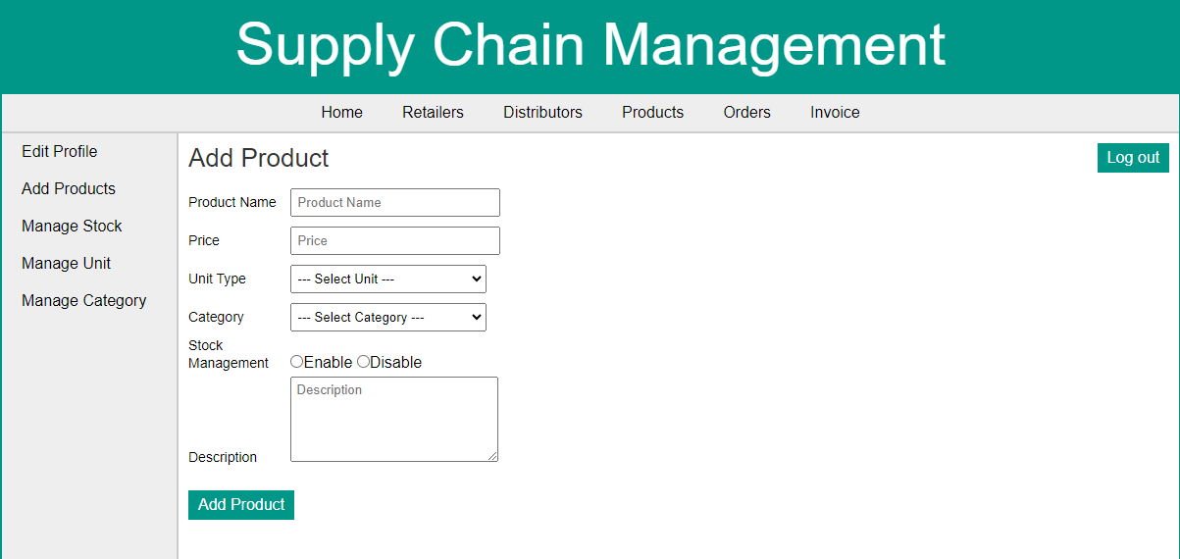
Module 3: Add Product 1.Intention of product page is to display the list of products to the customers. 2.After entering into text fields of product page, new product can be created. There is a provision to delete the product as well.

Slide 10
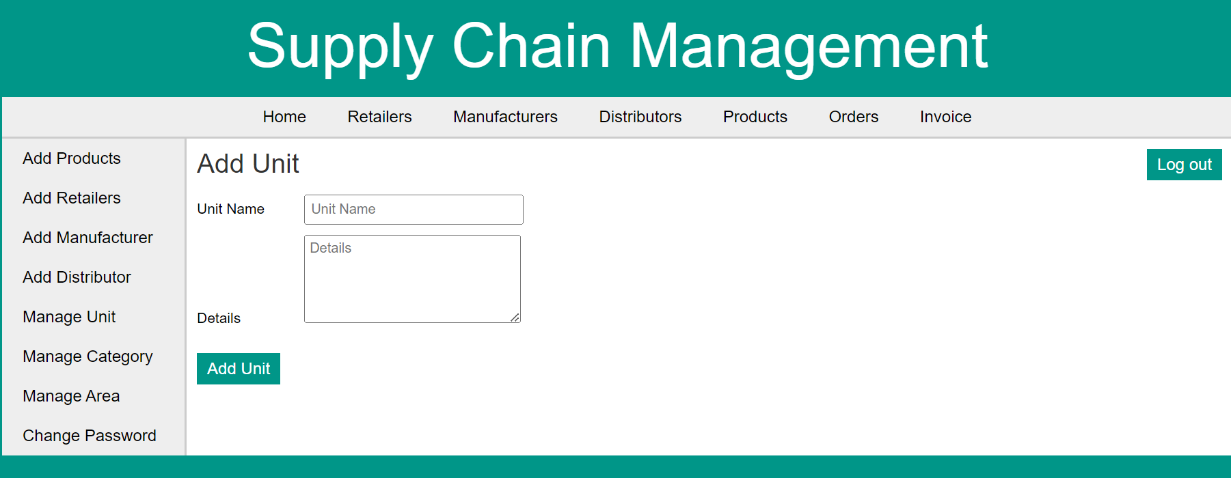
Module 5: Manage Unit 1. Provides list of units of all products and its description. 2. We can delete any existing unit and add unit provision exists to create a new unit under manage category section.

Slide 11
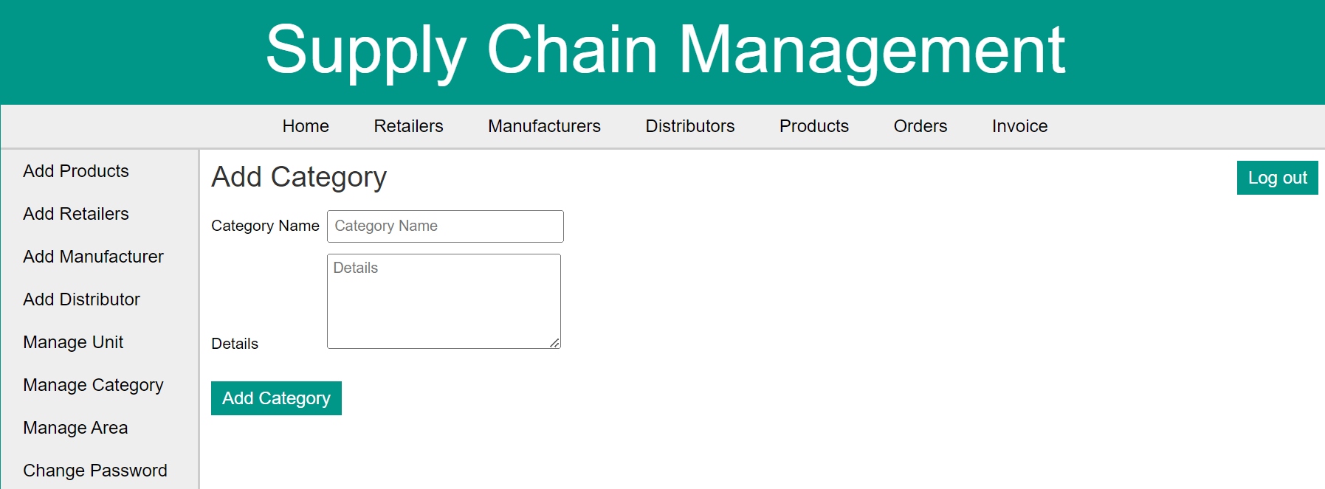
Module 6: Manage Category 1. Provides names of different categories and its description. 2. We can make a new entry of category of products and also delete the product under manage area section.

Slide 12
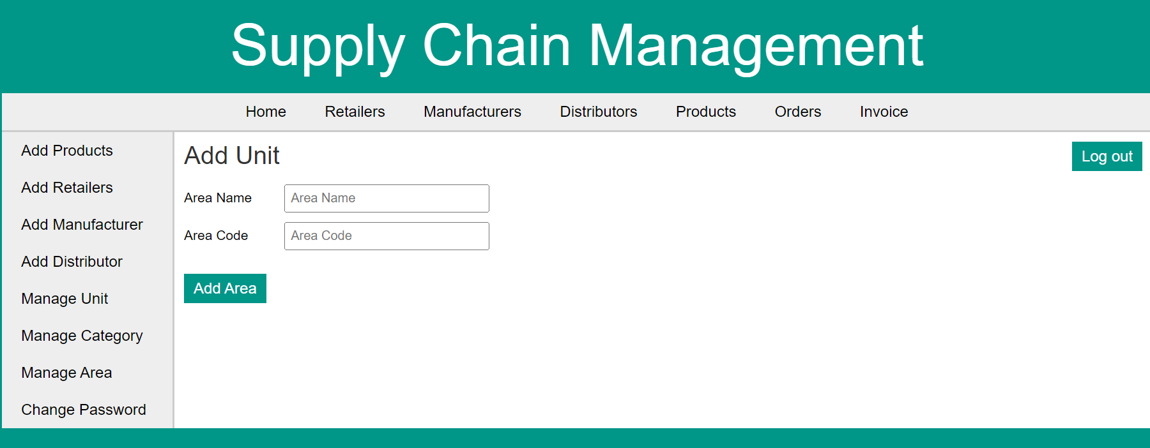
Module 7: Manage Area 1.Provides list of area names and area codes under manage area section. 2.We can make an entry of new area as well.

Slide 13
Project Business Workflow
Login to SCM as a admin click on login button, click on Add manufacturer link, enter all necessary details and click on add manufacturer button the manufacturer will be added in view manufacturer page, where we can edit and delete the manufacturer details
Login to SCM as a admin click on login button, click on Add Retailers link, enter all necessary details and click on add Retailer button the retailer will be added in retailers page, where we can edit and delete the retailer.

Slide 14
FUNCTIONAL DEPENDENCIES
Manufacturer
Manage Unit
Manage Category
Manage Stock
Add Manufacturer
Add Products
Orders
Admin
Retailer
Add Retailer
Invoice
Manage Area
Add Distributor

Slide 15
Effort Estimation
Us_id | us_name | task | Test case | Story point | mph | days
us_01 | Add retailer | t-01 | +-15 | 2 | 16 | 2days
us_02 | Add manufacturer | t-02 | +-15 | 2 | 16 | 2days
us_03 | Add distributor | t-03 | +-11 | 1 | 8 | 1days
us_04 | Add product | t-04 | +-8 | 1 | 8 | 1days
us_05 | Manage category | t-05 | +-8 | 1 | 8 | 1 days
us_06 | Manage unit | t-06 | +-7 | 1 | 8 | 1 days
 |  |  |  | 8 | 64 | 8 days

Slide 16
THANK YOU

